Slide 1
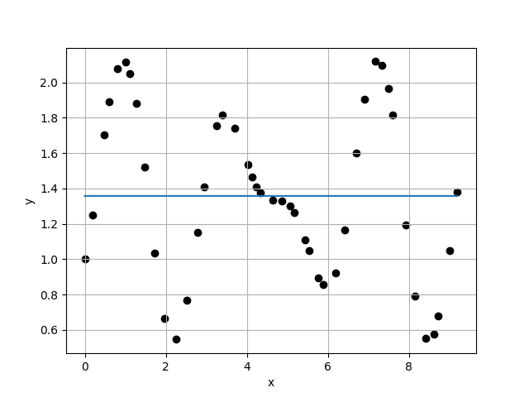
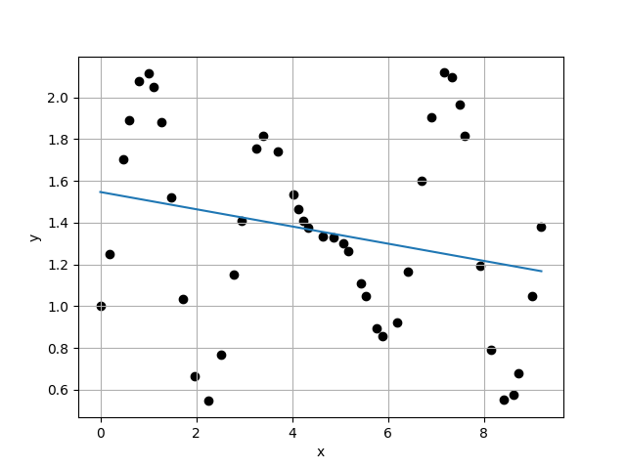
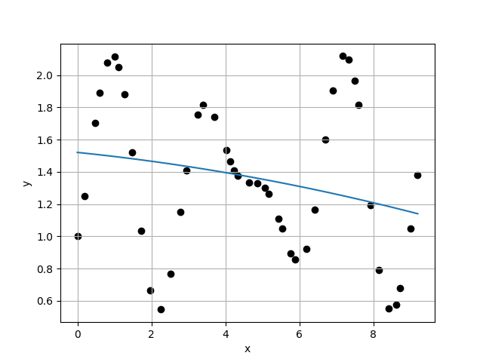
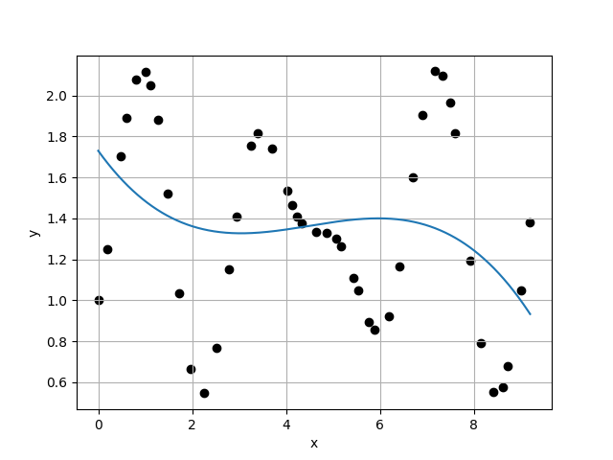
Case 1 :
Case 2 :
f(x) = 1.3579E+00
f(x) = 1.5470E+00 + -4.1230E-02 * x
4.6980E-01
4.6114E-01
1.0188E+00
9.8871E-01
Case 3 :
f(x) = 1.5209E+00 + -2.3492E-02 * x + -1.9422E-03 * x^2
Case 4 :
f(x) = 1.7304E+00 + -3.1918E-01 * x + 7.9197E-02 * x^2 + -5.8617E-03 * x^3
4.6641E-01
4.6262E-01
1.0082E+00
1.0111E+00

Slide 2
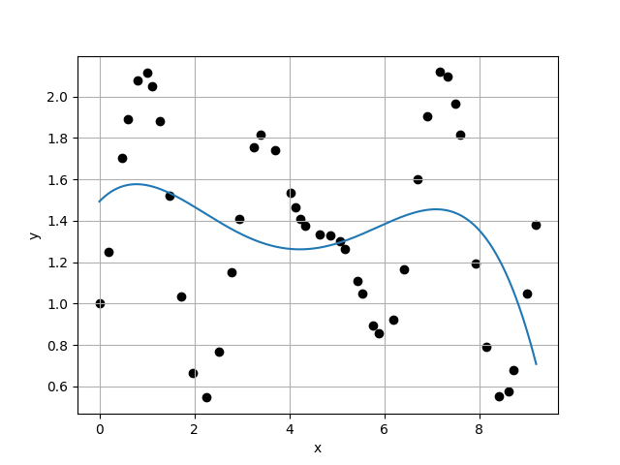
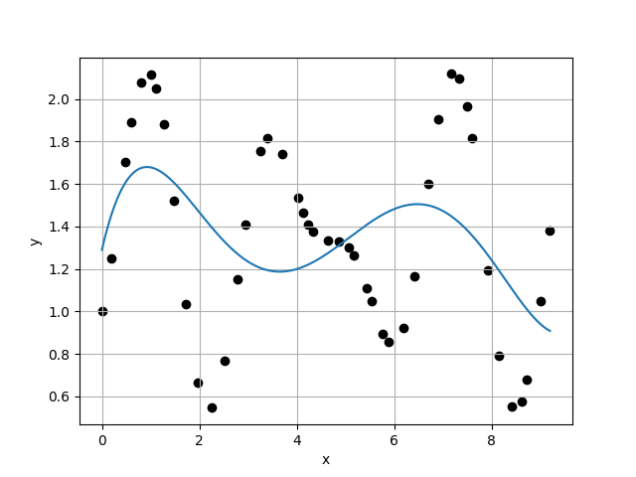
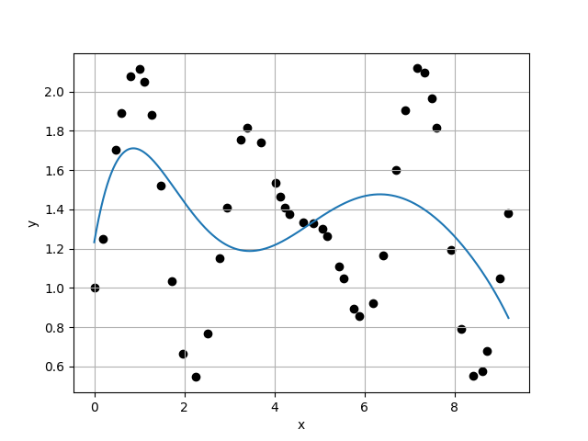
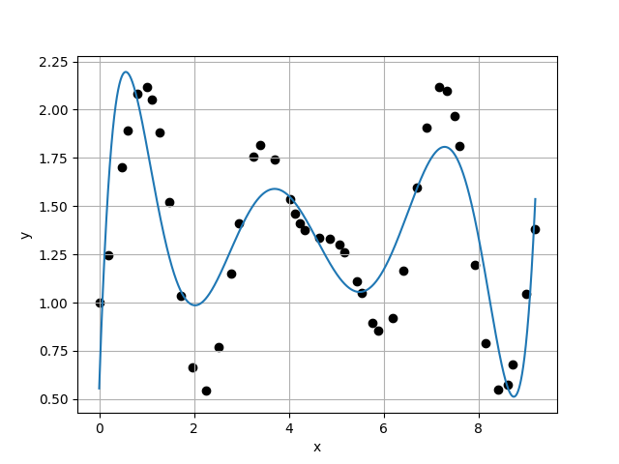
Case 5 :
Case 6 :
f(x) = 1.4933E+00 + 2.3636E-01 * x + -1.9591E-01 * x^2 + 4.0735E-02 * x^3 + -2.5263E-03 * x^4
f(x) = 1.2900E+00 + 9.9566E-01 * x + -8.0420E-01 * x^2 + 2.2094E-01 * x^3 + -2.4759E-02 * x^4 + 9.6882E-04 * x^5
4.5756E-01
4.5439E-01
1.0070E+00
9.8904E-01
Case 7 :
f(x) = 1.2327E+00 + 1.3293E+00 * x + -1.1990E+00 * x^2 + 3.9899E-01 * x^3 + -6.1697E-02 * x^4 + 4.5331E-03 * x^5 + -1.2961E-04 * x^6
Case 8 :
f(x) = 5.5533E-01 + 7.2956E+00 * x + -1.0875E+01 * x^2 + 6.4761E+00 * x^3 + -1.9091E+00 * x^4 + 2.9559E-01 * x^5 + -2.3004E-02 * x^6 + 7.0897E-04 * x^7
4.5943E-01
2.7578E-01
1.6659E+00
1.0633E+00

Slide 3
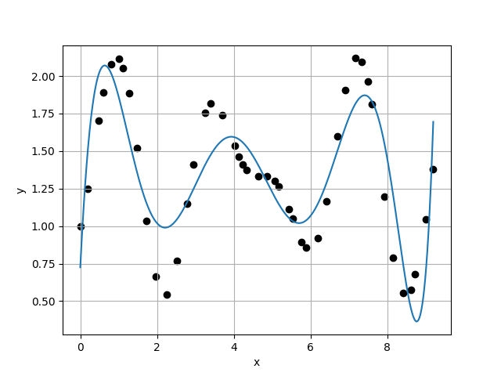
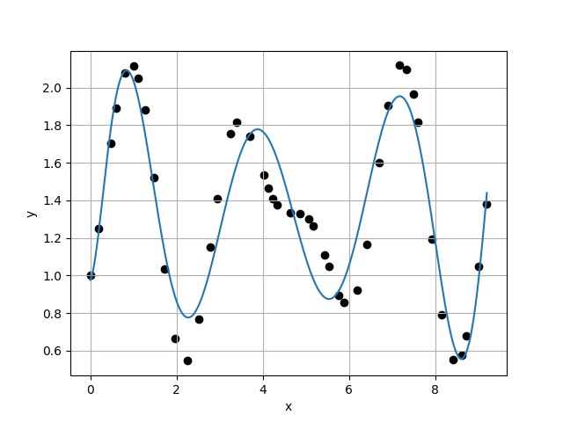
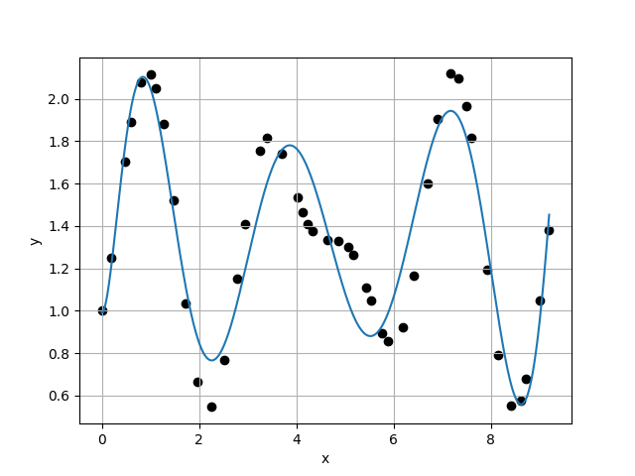
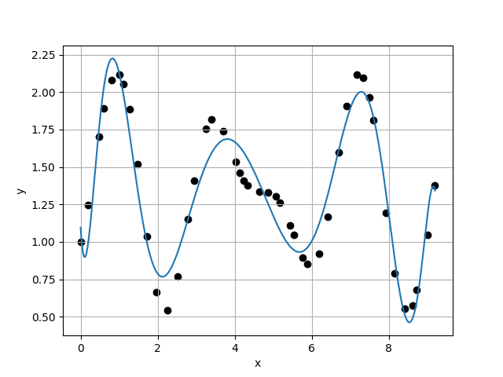
Case 9 :
Case 10 :
f(x) = 7.2528E-01 + 5.0926E+00 * x + -6.1768E+00 * x^2 + 2.5506E+00 * x^3 + -2.7270E-01 * x^4 + -7.8384E-02 * x^5 + 2.4625E-02 * x^6 + -2.4617E-03 * x^7 + 8.5967E-05 * x^8
f(x) = 9.7606E-01 + 3.6274E-01 * x + 6.7892E+00 * x^2 + -1.1446E+01 * x^3 + 7.4059E+00 * x^4 + -2.4656E+00 * x^5 + 4.6303E-01 * x^6 + -4.9552E-02 * x^7 + 2.8199E-03 * x^8 + -6.6236E-05 * x^9
2.5935E-01
1.8644E-01
1.3910E+00
9.8752E-01
Case 11 :
f(x) = 9.8979E-01 + -1.0199E-02 * x + 8.0635E+00 * x^2 + -1.3155E+01 * x^3 + 8.5837E+00 * x^4 + -2.9355E+00 * x^5 + 5.7780E-01 * x^6 + -6.6974E-02 * x^7 + 4.4228E-03 * x^8 + -1.4806E-04 * x^9 + 1.7782E-06 * x^10
Case 12 :
f(x) = 1.0952E+00 + -4.0845E+00 * x + 2.5052E+01 * x^2 + -4.0891E+01 * x^3 + 3.2076E+01 * x^4 + -1.4645E+01 * x^5 + 4.2387E+00 * x^6 + -8.0522E-01 * x^7 + 1.0036E-01 * x^8 + -7.9061E-03 * x^9 + 3.5690E-04 * x^10 + -7.0279E-06 * x^11
1.8880E-01
1.5609E-01
1.2096E+00
1.0358E+00

Slide 4
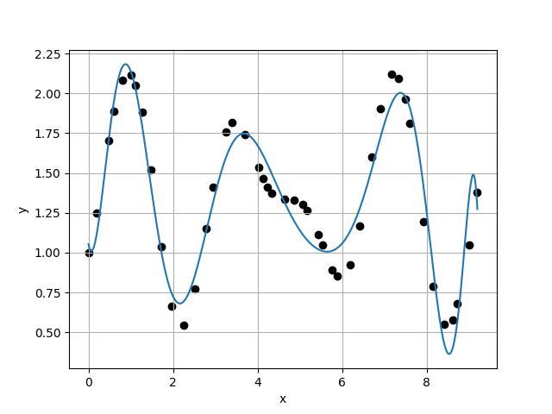
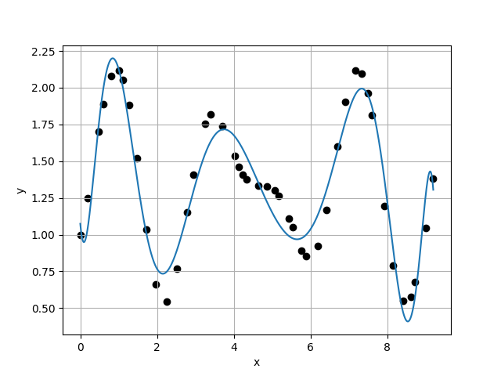

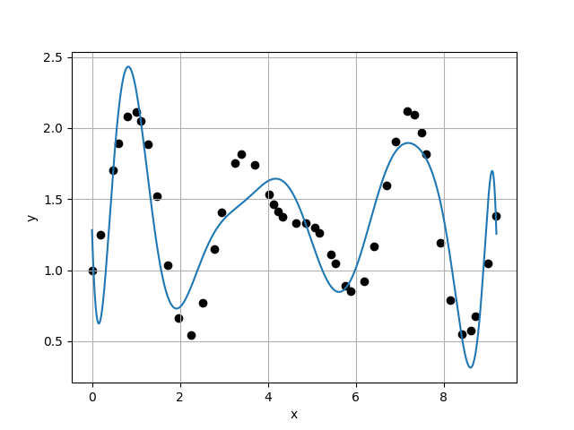
Case 13 :
Case 14 :
f(x) = 1.0524E+00 + -1.2382E+00 * x + 1.0009E+01 * x^2 + -1.0432E+01 * x^3 + 1.8984E-01 * x^4 + 5.0878E+00 * x^5 + -3.5135E+00 * x^6 + 1.2015E+00 * x^7 + -2.4642E-01 * x^8 + 3.1692E-02 * x^9 + -2.5116E-03 * x^10 + 1.1237E-04 * x^11 + -2.1747E-06 * x^12
f(x) = 1.0742E+00 + -2.8799E+00 * x + 1.9069E+01 * x^2 + -2.9520E+01 * x^3 + 2.1025E+01 * x^4 + -8.4258E+00 * x^5 + 2.0976E+00 * x^6 + -3.5310E-01 * x^7 + 4.6623E-02 * x^8 + -5.9176E-03 * x^9 + 7.1136E-04 * x^10 + -6.3178E-05 * x^11 + 3.2816E-06 * x^12 + -7.2886E-08 * x^13
1.5069E-01
1.5755E-01
9.5647E-01
1.0491E+00
Case 15 :
f(x) = 1.1039E+00 + -3.9565E+00 * x + 2.3244E+01 * x^2 + -3.5476E+01 * x^3 + 2.4846E+01 * x^4 + -9.3250E+00 * x^5 + 1.8668E+00 * x^6 + -1.3952E-01 * x^7 + -1.5719E-02 * x^8 + 3.2288E-03 * x^9 + 1.6676E-04 * x^10 + -9.3738E-05 * x^11 + 1.0622E-05 * x^12 + -5.4013E-07 * x^13 + 1.0745E-08 * x^14
Case 16 :
f(x) = 1.2824E+00 + -9.5659E+00 * x + 4.2090E+01 * x^2 + -5.3273E+01 * x^3 + 1.9255E+01 * x^4 + 1.3134E+01 * x^5 + -1.7083E+01 * x^6 + 8.4856E+00 * x^7 + -2.4457E+00 * x^8 + 4.3876E-01 * x^9 + -4.7101E-02 * x^10 + 2.2634E-03 * x^11 + 9.4540E-05 * x^12 + -2.0474E-05 * x^13 + 1.1518E-06 * x^14 + -2.3738E-08 * x^15
1.5018E-01
2.9081E-01
5.1643E-01
3.3047E+00

Slide 5
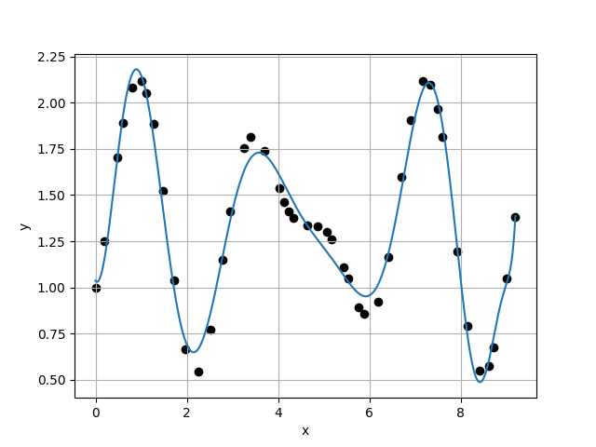
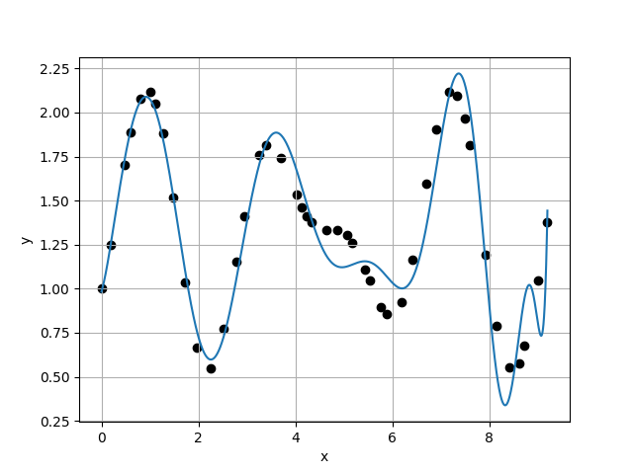
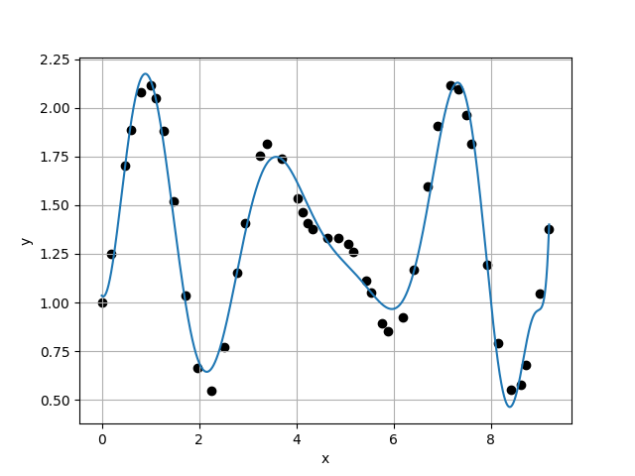
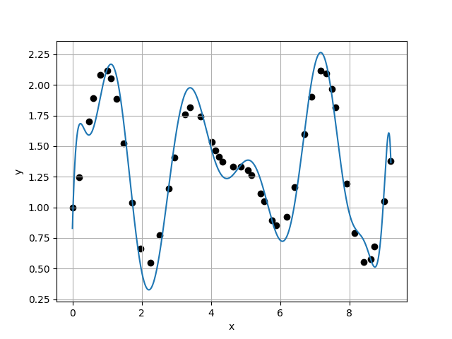
Case 17 :
Case 18 :
f(x) = 1.0367E+00 + -3.7558E-01 * x + 5.6212E+00 * x^2 + -2.1009E+00 * x^3 + -7.2818E+00 * x^4 + 8.1974E+00 * x^5 + -3.6753E+00 * x^6 + 7.8440E-01 * x^7 + -4.7804E-02 * x^8 + -1.2697E-02 * x^9 + 2.7211E-03 * x^10 + -1.3190E-04 * x^11 + -1.1511E-05 * x^12 + 8.6173E-07 * x^13 + 1.0356E-07 * x^14 + -1.2685E-08 * x^15 + 3.7655E-10 * x^16
f(x) = 9.8277E-01 + 9.0061E-01 * x + 3.9564E+00 * x^2 + -8.6614E+00 * x^3 + 1.0334E+01 * x^4 + -9.4644E+00 * x^5 + 5.7039E+00 * x^6 + -2.0471E+00 * x^7 + 4.0435E-01 * x^8 + -3.1568E-02 * x^9 + -2.4621E-03 * x^10 + 5.1210E-04 * x^11 + 2.7634E-05 * x^12 + -1.0347E-05 * x^13 + 4.1445E-07 * x^14 + 6.0251E-08 * x^15 + -6.3314E-09 * x^16 + 1.7623E-10 * x^17
8.8000E-02
1.7280E-01
5.0926E-01
1.7391E+00
Case 19 :
f(x) = 1.0355E+00 + -3.1975E-01 * x + 5.4596E+00 * x^2 + -2.0103E+00 * x^3 + -7.2822E+00 * x^4 + 8.3620E+00 * x^5 + -3.9782E+00 * x^6 + 1.0069E+00 * x^7 + -1.3568E-01 * x^8 + 7.2600E-03 * x^9 + 2.6790E-04 * x^10 + -2.6521E-05 * x^11 + -5.0856E-06 * x^12 + 1.0748E-06 * x^13 + -1.2505E-07 * x^14 + 6.3734E-09 * x^15 + 5.0104E-10 * x^16 + -7.7408E-11 * x^17 + 2.6274E-12 * x^18
Case 20 :
f(x) = 8.2853E-01 + 1.0223E+01 * x + -4.3781E+01 * x^2 + 8.3391E+01 * x^3 + -7.7201E+01 * x^4 + 3.4996E+01 * x^5 + -5.4393E+00 * x^6 + -1.6709E+00 * x^7 + 9.3202E-01 * x^8 + -1.6270E-01 * x^9 + 7.1773E-03 * x^10 + 1.0280E-03 * x^11 + -7.0090E-06 * x^12 + -2.7210E-05 * x^13 + 1.7253E-06 * x^14 + 1.8608E-07 * x^15 + -1.5196E-08 * x^16 + -1.4426E-09 * x^17 + 1.8511E-10 * x^18 + -5.4126E-12 * x^19
9.9359E-02
1.8274E-01
5.4373E-01
4.2623E-01

Slide 6
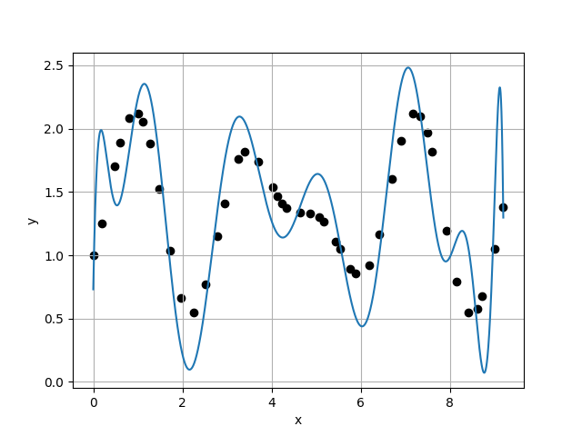
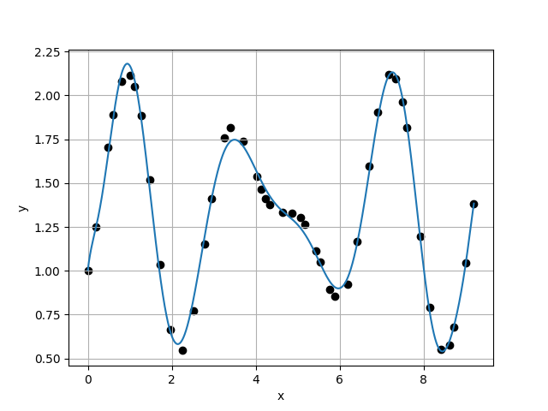
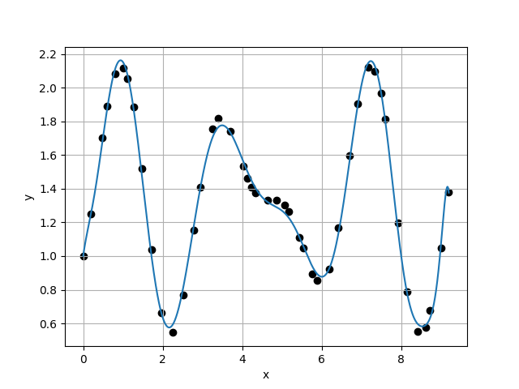
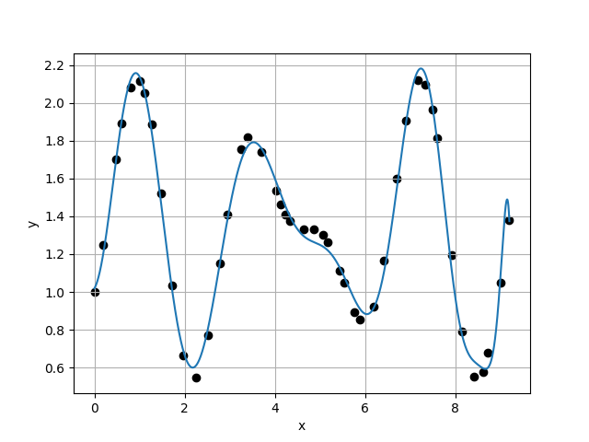
Case 21 :
Case 22 :
f(x) = 7.3097E-01 + 1.8282E+01 * x + -9.0844E+01 * x^2 + 1.8757E+02 * x^3 + -1.9506E+02 * x^4 + 1.1249E+02 * x^5 + -3.6953E+01 * x^6 + 6.4309E+00 * x^7 + -3.6174E-01 * x^8 + -4.6084E-02 * x^9 + 3.9522E-03 * x^10 + 4.6896E-04 * x^11 + 8.5930E-05 * x^12 + -3.1927E-05 * x^13 + 8.4877E-07 * x^14 + 3.7433E-07 * x^15 + -3.2802E-08 * x^16 + 3.5214E-10 * x^17 + -2.5953E-11 * x^18 + 8.9469E-12 * x^19 + -3.7575E-13 * x^20
f(x) = 1.0048E+00 + 1.9547E+00 * x + -7.3875E+00 * x^2 + 2.5673E+01 * x^3 + -3.7796E+01 * x^4 + 2.7822E+01 * x^5 + -1.1556E+01 * x^6 + 2.8189E+00 * x^7 + -3.8744E-01 * x^8 + 2.4216E-02 * x^9 + -2.4876E-04 * x^10 + 1.5779E-04 * x^11 + -5.0994E-05 * x^12 + 5.7878E-06 * x^13 + -4.3021E-07 * x^14 + 3.9683E-08 * x^15 + -4.3394E-09 * x^16 + 3.8014E-10 * x^17 + -1.6655E-11 * x^18 + -8.3845E-13 * x^19 + 1.3432E-13 * x^20 + -4.3853E-15 * x^21
4.2873E-01
5.4948E-02
7.8024E+00
1.2436E+00
Case 23 :
f(x) = 1.0005E+00 + 1.6896E+00 * x + -4.5596E+00 * x^2 + 1.6767E+01 * x^3 + -2.4583E+01 * x^4 + 1.6859E+01 * x^5 + -6.0525E+00 * x^6 + 1.0997E+00 * x^7 + -6.0022E-02 * x^8 + -1.0177E-02 * x^9 + 1.2053E-03 * x^10 + 9.8836E-05 * x^11 + -2.0159E-05 * x^12 + 1.3711E-06 * x^13 + -1.9752E-07 * x^14 + 1.5399E-08 * x^15 + 9.4486E-10 * x^16 + -1.2282E-10 * x^17 + 3.3507E-13 * x^18 + 6.0565E-13 * x^19 + -1.8073E-13 * x^20 + 2.0103E-14 * x^21 + -6.9463E-16 * x^22
Case 24 :
f(x) = 1.0188E+00 + 4.0391E-01 * x + 2.7161E+00 * x^2 + 9.9758E-01 * x^3 + -7.1876E+00 * x^4 + 5.9317E+00 * x^5 + -2.0094E+00 * x^6 + 2.6104E-01 * x^7 + 1.0923E-02 * x^8 + -4.8195E-03 * x^9 + -8.4288E-05 * x^10 + 5.9985E-05 * x^11 + 8.5306E-07 * x^12 + -1.0573E-07 * x^13 + -9.5036E-09 * x^14 + -1.2048E-08 * x^15 + -1.4730E-10 * x^16 + 3.2619E-10 * x^17 + -1.8768E-11 * x^18 + 3.1380E-13 * x^19 + -1.4269E-13 * x^20 + 8.0519E-17 * x^21 + 1.7816E-15 * x^22 + -8.4932E-17 * x^23
4.4184E-02
6.4189E-02
6.8834E-01
1.0730E+00

Slide 7
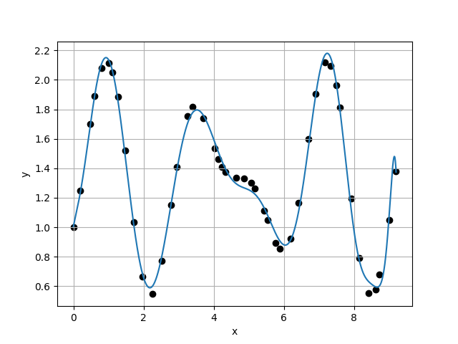
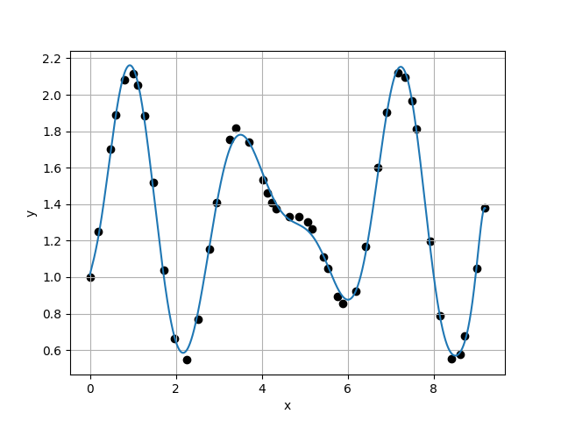
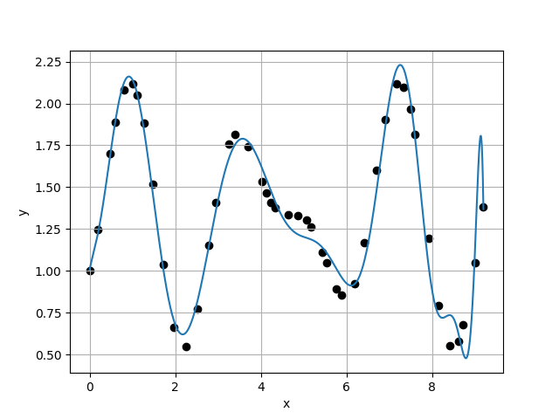
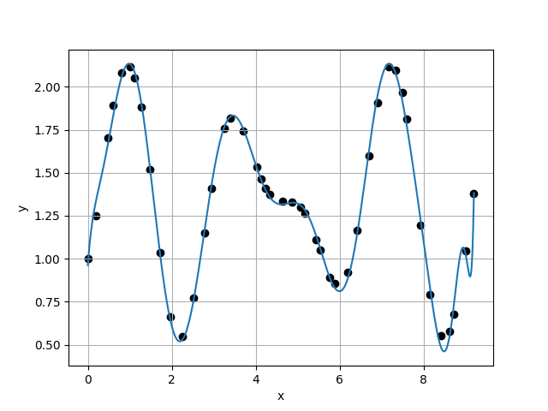
Case 25 :
Case 26 :
f(x) = 1.0051E+00 + 1.1227E+00 * x + -9.2243E-01 * x^2 + 8.2795E+00 * x^3 + -1.4852E+01 * x^4 + 1.0741E+01 * x^5 + -3.9288E+00 * x^6 + 7.6369E-01 * x^7 + -7.5945E-02 * x^8 + 4.7983E-03 * x^9 + -6.7081E-04 * x^10 + 6.0062E-05 * x^11 + 3.5547E-06 * x^12 + -8.5949E-08 * x^13 + -3.1872E-08 * x^14 + -1.6966E-08 * x^15 + 1.3040E-09 * x^16 + 1.4872E-10 * x^17 + -1.1521E-12 * x^18 + -4.6161E-14 * x^19 + -4.3379E-13 * x^20 + 4.4418E-14 * x^21 + -7.3112E-16 * x^22 + -4.2770E-17 * x^23 + 5.6385E-19 * x^24
f(x) = 1.0134E+00 + 9.2717E-01 * x + -4.0120E-01 * x^2 + 7.8862E+00 * x^3 + -1.4810E+01 * x^4 + 1.0706E+01 * x^5 + -3.7919E+00 * x^6 + 6.5952E-01 * x^7 + -4.0262E-02 * x^8 + -1.3425E-03 * x^9 + -2.0509E-04 * x^10 + 5.9841E-05 * x^11 + -9.7173E-07 * x^12 + 1.3257E-06 * x^13 + -2.1491E-07 * x^14 + -2.2167E-08 * x^15 + 3.3486E-09 * x^16 + 2.1400E-10 * x^17 + -1.2377E-11 * x^18 + -2.5744E-12 * x^19 + -6.1035E-14 * x^20 + 9.8828E-15 * x^21 + 2.7110E-15 * x^22 + -1.3192E-16 * x^23 + -1.2033E-17 * x^24 + 6.6459E-19 * x^25
5.9823E-02
4.6011E-02
1.3002E+00
3.7384E-01
Case 27 :
f(x) = 1.0074E+00 + 1.1987E+00 * x + -2.5211E+00 * x^2 + 1.5007E+01 * x^3 + -2.7090E+01 * x^4 + 2.2774E+01 * x^5 + -1.1016E+01 * x^6 + 3.3970E+00 * x^7 + -7.0740E-01 * x^8 + 1.0304E-01 * x^9 + -1.0402E-02 * x^10 + 5.1643E-04 * x^11 + 5.8510E-05 * x^12 + -1.4914E-05 * x^13 + 8.3930E-07 * x^14 + 3.5575E-08 * x^15 + 9.1261E-09 * x^16 + -2.8245E-09 * x^17 + 1.0348E-10 * x^18 + 1.4890E-11 * x^19 + -1.1937E-12 * x^20 + 9.5703E-14 * x^21 + 6.5371E-16 * x^22 + -3.8625E-15 * x^23 + 5.3530E-16 * x^24 + -2.7569E-17 * x^25 + 4.8811E-19 * x^26
Case 28 :
f(x) = 9.6216E-01 + 3.2577E+00 * x + -1.0784E+01 * x^2 + 2.5166E+01 * x^3 + -2.8476E+01 * x^4 + 1.5918E+01 * x^5 + -4.3638E+00 * x^6 + 4.1269E-01 * x^7 + 5.1447E-02 * x^8 + -9.3721E-03 * x^9 + -1.1948E-03 * x^10 + 2.2958E-04 * x^11 + 1.3633E-05 * x^12 + -3.2894E-06 * x^13 + 6.7939E-08 * x^14 + 4.5191E-09 * x^15 + -1.9130E-09 * x^16 + 1.8675E-10 * x^17 + 1.0682E-11 * x^18 + 3.8231E-12 * x^19 + -4.9514E-13 * x^20 + -3.2165E-14 * x^21 + -9.6013E-16 * x^22 + 4.1388E-16 * x^23 + 3.8124E-17 * x^24 + 1.8568E-19 * x^25 + -7.4214E-19 * x^26 + 3.5740E-20 * x^27
1.2308E-01
5.1889E-02
2.3720E+00
9.5039E-01

Slide 8
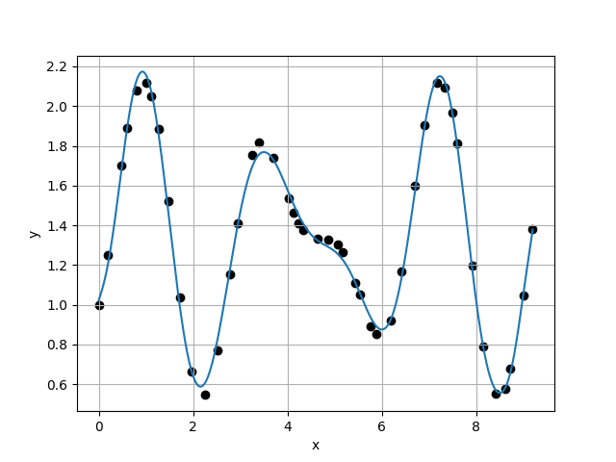
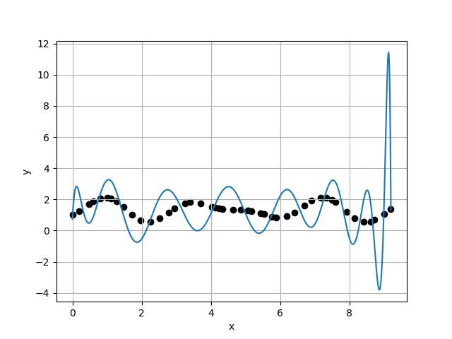
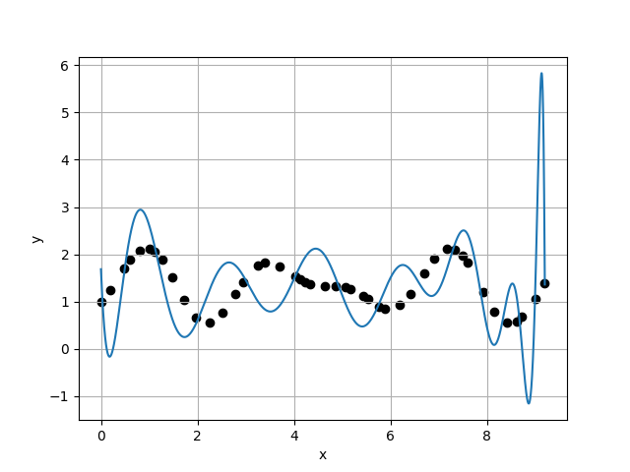
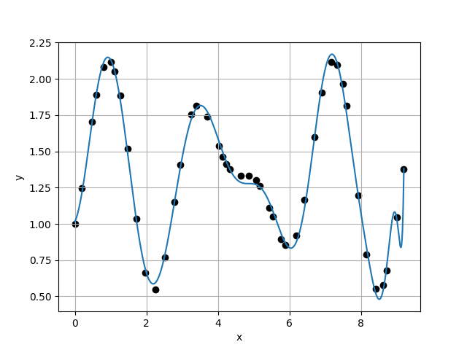
Case 29 :
Case 30 :
f(x) = 1.0221E+00 + 7.1689E-01 * x + 2.6065E-02 * x^2 + 8.2088E+00 * x^3 + -1.6261E+01 * x^4 + 1.2134E+01 * x^5 + -4.4123E+00 * x^6 + 7.5280E-01 * x^7 + -1.7981E-02 * x^8 + -1.2795E-02 * x^9 + 1.4196E-03 * x^10 + 2.5878E-05 * x^11 + -4.5739E-06 * x^12 + -4.8363E-07 * x^13 + -9.2717E-08 * x^14 + 1.0451E-08 * x^15 + 2.8127E-09 * x^16 + -2.6106E-10 * x^17 + -2.4096E-11 * x^18 + 1.3738E-12 * x^19 + 1.8819E-13 * x^20 + 1.8943E-14 * x^21 + -3.4286E-16 * x^22 + -7.4128E-16 * x^23 + 2.3165E-17 * x^24 + 4.9672E-18 * x^25 + 1.4263E-19 * x^26 + -6.1218E-20 * x^27 + 2.4116E-21 * x^28
f(x) = 7.3457E-01 + 4.2523E+01 * x + -2.8185E+02 * x^2 + 7.0288E+02 * x^3 + -8.6889E+02 * x^4 + 6.0174E+02 * x^5 + -2.4453E+02 * x^6 + 5.6901E+01 * x^7 + -6.3068E+00 * x^8 + -2.6112E-02 * x^9 + 5.8082E-02 * x^10 + 1.6733E-03 * x^11 + -8.5176E-04 * x^12 + 4.1605E-05 * x^13 + -1.3357E-05 * x^14 + 2.4928E-06 * x^15 + -7.7379E-08 * x^16 + 2.0468E-09 * x^17 + -1.2067E-09 * x^18 + 1.2935E-11 * x^19 + -8.6208E-12 * x^20 + 7.3034E-13 * x^21 + 3.1762E-13 * x^22 + -1.3431E-14 * x^23 + -2.5183E-15 * x^24 + 2.2184E-17 * x^25 + 7.7023E-18 * x^26 + 9.2216E-19 * x^27 + -5.8219E-20 * x^28 + -5.8057E-22 * x^29
5.4597E-02
1.8549E+00
2.9434E-02
1.7327E+00
Case 31 :
f(x) = 1.6831E+00 + -2.4295E+01 * x + 1.0134E+02 * x^2 + -1.4845E+02 * x^3 + 1.0655E+02 * x^4 + -4.5843E+01 * x^5 + 1.5844E+01 * x^6 + -5.5151E+00 * x^7 + 1.4958E+00 * x^8 + -1.9076E-01 * x^9 + -1.0629E-02 * x^10 + 4.8708E-03 * x^11 + 4.7392E-05 * x^12 + -9.5937E-05 * x^13 + 2.2442E-06 * x^14 + 8.3083E-07 * x^15 + 1.4069E-08 * x^16 + -4.3417E-09 * x^17 + -4.9427E-10 * x^18 + -7.5989E-11 * x^19 + 1.0390E-11 * x^20 + 1.2214E-12 * x^21 + 1.3685E-14 * x^22 + -2.4756E-14 * x^23 + -9.4505E-16 * x^24 + 3.6525E-16 * x^25 + 7.7911E-19 * x^26 + -2.6200E-18 * x^27 + 5.1728E-21 * x^28 + 1.6398E-20 * x^29 + -6.7083E-22 * x^30
Case 32 :
f(x) = 1.0141E+00 + 5.3506E-01 * x + 2.4711E+00 * x^2 + 6.0418E-01 * x^3 + -5.9069E+00 * x^4 + 4.7496E+00 * x^5 + -1.5258E+00 * x^6 + 1.9244E-01 * x^7 + -1.2816E-03 * x^8 + 2.2710E-04 * x^9 + -4.0341E-04 * x^10 + 1.2530E-06 * x^11 + 7.4513E-06 * x^12 + -3.1659E-07 * x^13 + 7.7565E-08 * x^14 + -1.5093E-08 * x^15 + -5.1530E-10 * x^16 + 7.1122E-11 * x^17 + 6.5910E-12 * x^18 + 1.0361E-14 * x^19 + 1.4217E-13 * x^20 + -1.1590E-14 * x^21 + -8.6710E-16 * x^22 + -1.7898E-17 * x^23 + -1.1552E-17 * x^24 + 5.7664E-19 * x^25 + 1.5372E-19 * x^26 + 5.5272E-21 * x^27 + 6.1161E-22 * x^28 + -9.0914E-23 * x^29 + -2.4001E-23 * x^30 + 1.7094E-24 * x^31
1.0705E+00
6.2802E-02
1.7046E+01
4.8674E-01

Slide 9
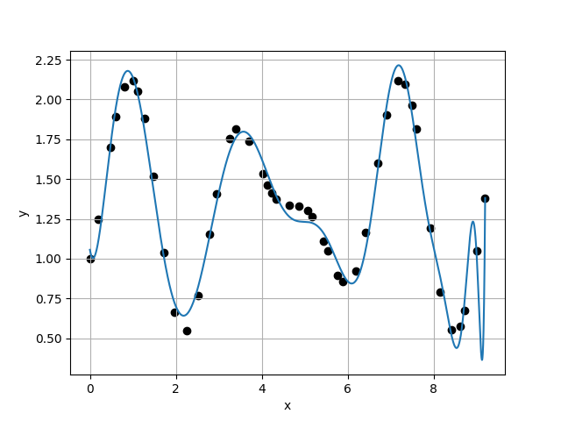
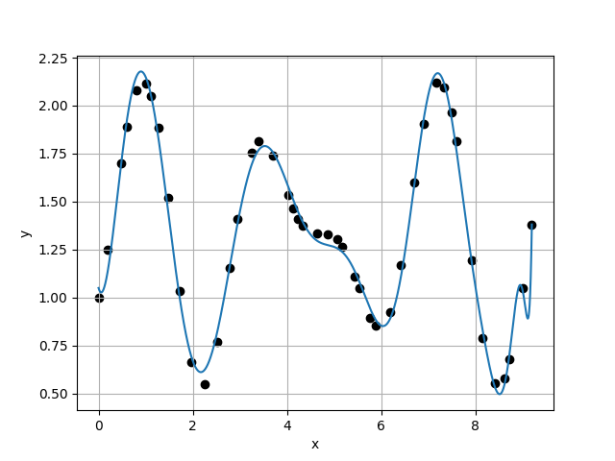
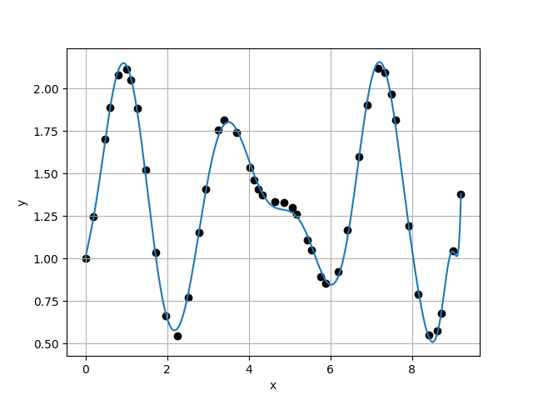
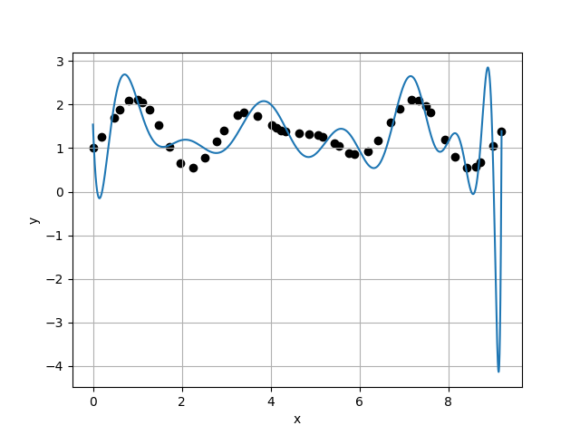
Case 33 :
Case 34 :
f(x) = 1.0561E+00 + -1.4914E+00 * x + 1.1787E+01 * x^2 + -1.5425E+01 * x^3 + 7.2697E+00 * x^4 + -5.1592E-01 * x^5 + -9.2157E-01 * x^6 + 5.0019E-01 * x^7 + -1.4203E-01 * x^8 + 2.4497E-02 * x^9 + -2.1394E-03 * x^10 + -1.1243E-05 * x^11 + 1.5353E-05 * x^12 + -1.4000E-08 * x^13 + -1.3034E-08 * x^14 + -4.8325E-08 * x^15 + 6.4822E-09 * x^16 + 2.1848E-10 * x^17 + -3.1928E-11 * x^18 + -8.3644E-12 * x^19 + -1.7872E-14 * x^20 + 1.3035E-13 * x^21 + 3.5713E-15 * x^22 + -7.5991E-16 * x^23 + -6.8797E-17 * x^24 + 8.6959E-18 * x^25 + -8.8308E-19 * x^26 + -5.3794E-20 * x^27 + 1.2382E-20 * x^28 + 6.3254E-22 * x^29 + 4.6306E-23 * x^30 + -2.4286E-23 * x^31 + 1.1661E-24 * x^32
f(x) = 1.0495E+00 + -8.5356E-01 * x + 8.3102E+00 * x^2 + -8.7176E+00 * x^3 + 1.2848E+00 * x^4 + 1.9757E+00 * x^5 + -1.1347E+00 * x^6 + 2.6909E-01 * x^7 + -3.8398E-02 * x^8 + 5.0768E-03 * x^9 + -5.5887E-04 * x^10 + 7.6837E-06 * x^11 + 1.9924E-06 * x^12 + 7.1016E-07 * x^13 + -1.0737E-07 * x^14 + 2.0878E-09 * x^15 + 3.1145E-10 * x^16 + 2.6649E-11 * x^17 + -2.3828E-11 * x^18 + 1.9105E-12 * x^19 + 2.6502E-15 * x^20 + 2.8090E-14 * x^21 + -6.0969E-16 * x^22 + -3.8873E-16 * x^23 + -1.1148E-17 * x^24 + 1.2941E-19 * x^25 + 4.4765E-19 * x^26 + 2.2184E-21 * x^27 + -1.5795E-21 * x^28 + -2.2878E-22 * x^29 + 6.5772E-23 * x^30 + -9.4695E-24 * x^31 + 5.8675E-25 * x^32 + -1.1266E-26 * x^33
1.2903E-01
8.7134E-02
1.4808E+00
1.6389E+00
Case 35 :
f(x) = 1.0034E+00 + 1.2021E+00 * x + -1.2121E+00 * x^2 + 8.4913E+00 * x^3 + -1.4543E+01 * x^4 + 1.0136E+01 * x^5 + -3.4960E+00 * x^6 + 5.9037E-01 * x^7 + -3.0697E-02 * x^8 + -3.8617E-03 * x^9 + 5.6299E-04 * x^10 + -3.2027E-05 * x^11 + -1.6605E-06 * x^12 + 1.3860E-06 * x^13 + -7.7685E-08 * x^14 + -2.0053E-08 * x^15 + 1.9211E-09 * x^16 + -3.2600E-11 * x^17 + -1.2549E-12 * x^18 + 1.3385E-12 * x^19 + -1.4066E-13 * x^20 + 1.1177E-14 * x^21 + 4.8744E-16 * x^22 + -2.5292E-16 * x^23 + -2.2282E-17 * x^24 + 2.6073E-18 * x^25 + 2.8365E-19 * x^26 + 1.2539E-20 * x^27 + -3.2638E-21 * x^28 + -1.6437E-22 * x^29 + 4.9609E-24 * x^30 + 1.0364E-24 * x^31 + 1.5280E-25 * x^32 + -1.9891E-26 * x^33 + 5.7365E-28 * x^34
Case 36 :
f(x) = 1.5398E+00 + -2.7394E+01 * x + 1.4294E+02 * x^2 + -2.7349E+02 * x^3 + 2.6778E+02 * x^4 + -1.5189E+02 * x^5 + 5.2340E+01 * x^6 + -1.1044E+01 * x^7 + 1.4371E+00 * x^8 + -1.3698E-01 * x^9 + 1.5166E-02 * x^10 + -1.3415E-03 * x^11 + -3.1950E-06 * x^12 + 2.9671E-06 * x^13 + 7.7666E-07 * x^14 + -6.4433E-08 * x^15 + 2.7678E-08 * x^16 + -4.9294E-09 * x^17 + 6.9170E-11 * x^18 + 1.5040E-11 * x^19 + -1.3306E-12 * x^20 + 3.7295E-13 * x^21 + -6.3602E-15 * x^22 + -1.0845E-15 * x^23 + -1.2603E-16 * x^24 + 1.5089E-17 * x^25 + -3.6797E-18 * x^26 + 2.7580E-20 * x^27 + 8.5523E-21 * x^28 + 5.1148E-21 * x^29 + 6.2852E-23 * x^30 + -4.5671E-23 * x^31 + -5.2454E-24 * x^32 + 1.1455E-24 * x^33 + -8.2912E-26 * x^34 + 2.5627E-27 * x^35
5.3166E-02
9.5759E-01
5.5520E-02
4.2572E+00

Slide 10
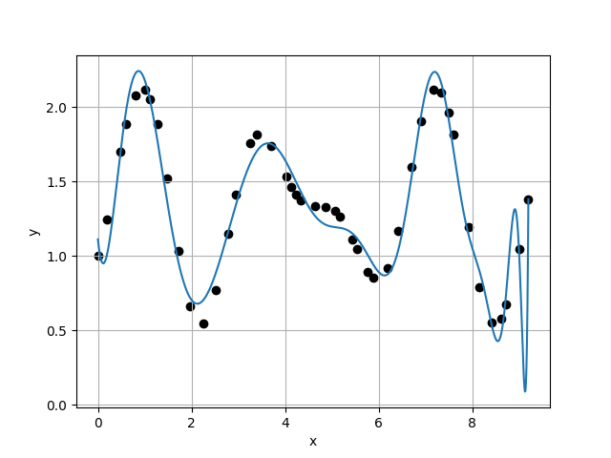
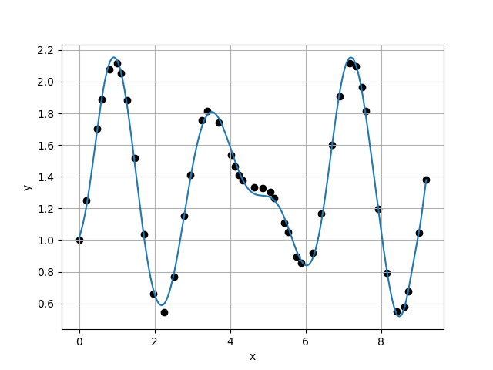
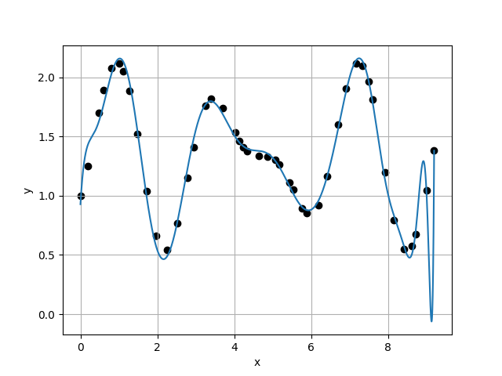
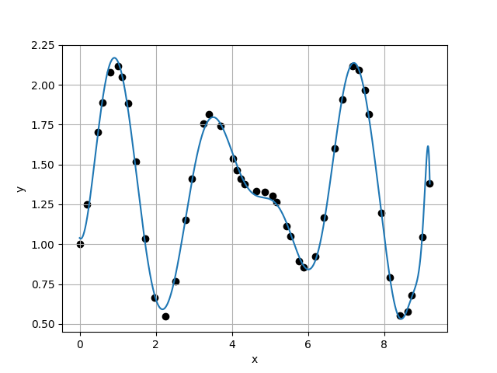
Case 37 :
Case 38 :
f(x) = 1.1115E+00 + -3.0361E+00 * x + 1.6110E+01 * x^2 + -1.6941E+01 * x^3 + 8.5174E-01 * x^4 + 8.7055E+00 * x^5 + -6.4899E+00 * x^6 + 2.2361E+00 * x^7 + -3.8674E-01 * x^8 + 1.8945E-02 * x^9 + 3.9470E-03 * x^10 + -4.9405E-04 * x^11 + -1.0122E-05 * x^12 + 2.3899E-07 * x^13 + 5.2714E-07 * x^14 + -3.0307E-08 * x^15 + 8.0918E-09 * x^16 + -1.4170E-09 * x^17 + -2.0499E-11 * x^18 + 5.9561E-12 * x^19 + 2.5611E-13 * x^20 + 1.2578E-13 * x^21 + -1.2939E-14 * x^22 + -1.1742E-16 * x^23 + 3.8364E-17 * x^24 + -2.3253E-17 * x^25 + 2.2660E-18 * x^26 + 1.3581E-19 * x^27 + -1.7136E-20 * x^28 + -4.1555E-22 * x^29 + -5.4417E-24 * x^30 + 1.1983E-23 * x^31 + -9.5289E-26 * x^32 + -1.1432E-25 * x^33 + 1.2074E-26 * x^34 + -9.4240E-28 * x^35 + 3.7370E-29 * x^36
f(x) = 1.0143E+00 + 6.8188E-01 * x + 1.2665E+00 * x^2 + 4.0117E+00 * x^3 + -1.0634E+01 * x^4 + 8.4419E+00 * x^5 + -3.2371E+00 * x^6 + 6.5333E-01 * x^7 + -6.0850E-02 * x^8 + -8.9005E-04 * x^9 + 8.1957E-04 * x^10 + -5.1237E-05 * x^11 + -8.6970E-06 * x^12 + 5.7832E-07 * x^13 + 2.1946E-07 * x^14 + -1.2332E-08 * x^15 + -1.9813E-09 * x^16 + -4.8919E-11 * x^17 + 6.9633E-13 * x^18 + 3.7628E-12 * x^19 + 3.5022E-14 * x^20 + -1.8925E-14 * x^21 + -7.7526E-16 * x^22 + 8.5778E-17 * x^23 + -2.4914E-18 * x^24 + -5.8912E-18 * x^25 + 4.0403E-19 * x^26 + 4.4403E-20 * x^27 + -6.3603E-21 * x^28 + 1.0621E-21 * x^29 + -4.9662E-23 * x^30 + -9.9178E-25 * x^31 + -2.9574E-25 * x^32 + -7.5980E-26 * x^33 + 1.2037E-26 * x^34 + 3.1336E-29 * x^35 + -3.2591E-29 * x^36 + 2.3554E-31 * x^37
2.2493E-01
7.0914E-02
3.1720E+00
4.7570E-01
Case 39 :
f(x) = 9.2815E-01 + 5.4240E+00 * x + -2.2003E+01 * x^2 + 4.6354E+01 * x^3 + -4.6886E+01 * x^4 + 2.2830E+01 * x^5 + -4.1687E+00 * x^6 + -6.9635E-01 * x^7 + 4.3205E-01 * x^8 + -5.3922E-02 * x^9 + -3.5050E-03 * x^10 + 9.9994E-04 * x^11 + 3.8955E-05 * x^12 + -1.2816E-05 * x^13 + -4.6489E-07 * x^14 + 6.1356E-08 * x^15 + 1.4384E-08 * x^16 + -1.6575E-09 * x^17 + 1.4246E-10 * x^18 + -7.2490E-12 * x^19 + -4.0451E-13 * x^20 + -8.0085E-14 * x^21 + 1.7072E-15 * x^22 + 1.7305E-16 * x^23 + 2.5415E-16 * x^24 + -7.2529E-18 * x^25 + -1.5910E-18 * x^26 + 9.0547E-20 * x^27 + -1.0309E-21 * x^28 + -2.4273E-21 * x^29 + 1.4732E-22 * x^30 + 4.1207E-24 * x^31 + 2.2602E-24 * x^32 + -2.4416E-25 * x^33 + -1.0479E-26 * x^34 + 1.2049E-27 * x^35 + 4.0823E-28 * x^36 + -6.4254E-29 * x^37 + 2.5573E-30 * x^38
Case 40 :
f(x) = 1.0396E+00 + -3.3914E-01 * x + 6.0324E+00 * x^2 + -5.1804E+00 * x^3 + -9.3671E-01 * x^4 + 2.1290E+00 * x^5 + -5.7436E-01 * x^6 + -6.9495E-02 * x^7 + 5.4816E-02 * x^8 + -8.2489E-03 * x^9 + 2.9622E-04 * x^10 + -4.0628E-06 * x^11 + 3.9613E-06 * x^12 + 2.6054E-07 * x^13 + -7.0373E-08 * x^14 + -1.2638E-09 * x^15 + 5.7241E-11 * x^16 + 7.8868E-12 * x^17 + -3.2456E-13 * x^18 + 1.9836E-13 * x^19 + 7.4090E-14 * x^20 + -6.5612E-15 * x^21 + 2.5098E-16 * x^22 + 2.0271E-17 * x^23 + -1.6030E-18 * x^24 + -9.6041E-19 * x^25 + -1.7613E-20 * x^26 + -2.0934E-20 * x^27 + 1.9881E-21 * x^28 + 7.4861E-23 * x^29 + 3.2896E-23 * x^30 + -1.5684E-24 * x^31 + 4.5844E-25 * x^32 + -8.7116E-26 * x^33 + -2.5494E-27 * x^34 + 2.4638E-28 * x^35 + 3.0042E-29 * x^36 + 6.5341E-31 * x^37 + 4.3082E-32 * x^38 + -1.4835E-32 * x^39
1.4907E-01
8.8909E-02
1.6767E+00
1.4210E+00

Slide 11
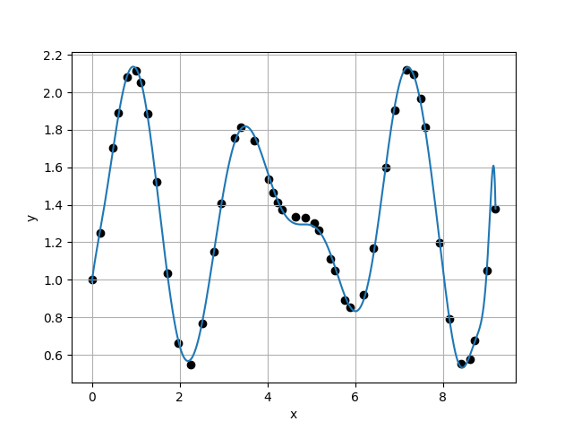
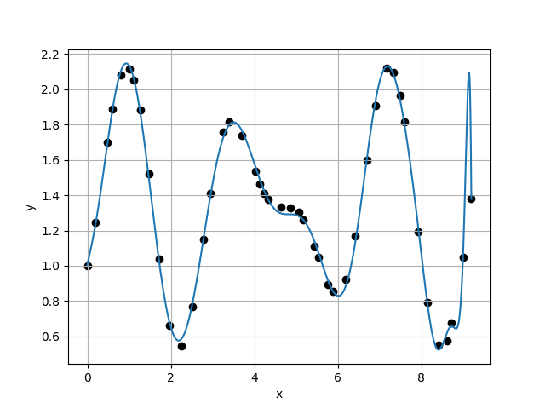
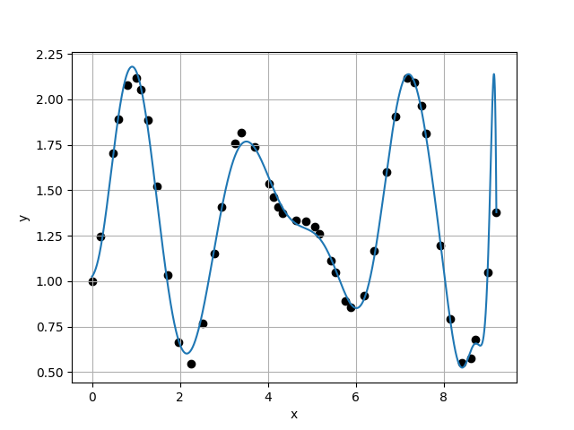
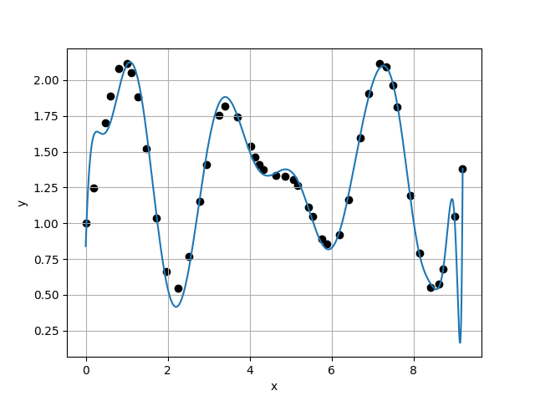
Case 41 :
Case 42 :
f(x) = 9.8708E-01 + 1.8294E+00 * x + -3.7963E+00 * x^2 + 1.2513E+01 * x^3 + -1.7551E+01 * x^4 + 1.1259E+01 * x^5 + -3.6621E+00 * x^6 + 5.8117E-01 * x^7 + -3.0832E-02 * x^8 + -3.6603E-05 * x^9 + -7.3536E-04 * x^10 + 1.3430E-04 * x^11 + 8.0130E-07 * x^12 + -1.5849E-06 * x^13 + 6.4089E-08 * x^14 + 1.3447E-08 * x^15 + -9.0971E-10 * x^16 + -4.3435E-11 * x^17 + -2.0221E-11 * x^18 + 1.4389E-12 * x^19 + 2.0993E-13 * x^20 + 1.4604E-14 * x^21 + -2.1891E-16 * x^22 + -1.5610E-16 * x^23 + -5.6007E-17 * x^24 + 3.6716E-18 * x^25 + -3.6243E-19 * x^26 + 6.2728E-20 * x^27 + -3.3368E-21 * x^28 + 5.7147E-22 * x^29 + 2.6130E-23 * x^30 + -5.3712E-24 * x^31 + 4.5586E-26 * x^32 + -7.2329E-26 * x^33 + -6.4685E-27 * x^34 + 1.5974E-27 * x^35 + -4.3316E-30 * x^36 + 1.4130E-30 * x^37 + -8.4681E-31 * x^38 + 3.6221E-32 * x^39 + -1.4320E-34 * x^40
f(x) = 1.0048E+00 + 1.0914E+00 * x + -4.6786E-01 * x^2 + 6.6062E+00 * x^3 + -1.2160E+01 * x^4 + 8.4474E+00 * x^5 + -2.7973E+00 * x^6 + 4.2787E-01 * x^7 + -1.5405E-02 * x^8 + -1.8543E-03 * x^9 + -2.2265E-04 * x^10 + 5.0719E-05 * x^11 + 2.2686E-06 * x^12 + -4.7086E-07 * x^13 + 5.1582E-09 * x^14 + 1.1458E-09 * x^15 + -3.7063E-10 * x^16 + 2.8526E-12 * x^17 + 2.5671E-12 * x^18 + -4.7608E-13 * x^19 + 7.0646E-14 * x^20 + 7.5717E-15 * x^21 + -2.6534E-16 * x^22 + -1.2882E-16 * x^23 + 1.1356E-17 * x^24 + -1.5035E-18 * x^25 + 8.7812E-20 * x^26 + 1.6540E-21 * x^27 + -1.8528E-21 * x^28 + 8.9132E-23 * x^29 + -5.4010E-24 * x^30 + 2.8756E-24 * x^31 + 4.0731E-26 * x^32 + 1.3826E-26 * x^33 + 8.0947E-29 * x^34 + -6.3205E-28 * x^35 + 2.0649E-29 * x^36 + -1.5784E-30 * x^37 + -2.1212E-31 * x^38 + 4.1866E-32 * x^39 + 5.5257E-33 * x^40 + -5.1176E-34 * x^41
6.2567E-02
8.9450E-02
6.9947E-01
5.1890E-01
Case 43 :
f(x) = 1.0254E+00 + 3.1390E-01 * x + 1.9144E+00 * x^2 + 5.5138E+00 * x^3 + -1.5503E+01 * x^4 + 1.3804E+01 * x^5 + -6.4609E+00 * x^6 + 1.8772E+00 * x^7 + -3.8104E-01 * x^8 + 6.0595E-02 * x^9 + -7.9751E-03 * x^10 + 8.2791E-04 * x^11 + -6.6003E-05 * x^12 + 4.0008E-06 * x^13 + -1.9915E-08 * x^14 + -1.8117E-09 * x^15 + -9.2379E-09 * x^16 + 1.1406E-09 * x^17 + 4.2460E-11 * x^18 + -6.1451E-12 * x^19 + -1.3480E-13 * x^20 + -8.4418E-14 * x^21 + -1.9312E-15 * x^22 + 1.8193E-15 * x^23 + -4.8168E-17 * x^24 + 3.1592E-18 * x^25 + 2.2233E-18 * x^26 + -4.4886E-19 * x^27 + -6.2196E-21 * x^28 + 1.9527E-21 * x^29 + -5.8761E-23 * x^30 + -3.5049E-24 * x^31 + 4.7456E-24 * x^32 + -1.2990E-25 * x^33 + -1.2667E-26 * x^34 + -3.5232E-27 * x^35 + 3.8266E-28 * x^36 + -4.3460E-29 * x^37 + 1.1768E-30 * x^38 + 5.0214E-31 * x^39 + -1.8163E-32 * x^40 + -2.2425E-33 * x^41 + 9.9453E-35 * x^42
Case 44 :
f(x) = 8.3969E-01 + 8.9535E+00 * x + -3.7326E+01 * x^2 + 7.2927E+01 * x^3 + -7.1718E+01 * x^4 + 3.7470E+01 * x^5 + -1.0160E+01 * x^6 + 1.0308E+00 * x^7 + 1.2455E-01 * x^8 + -3.8960E-02 * x^9 + 2.4674E-03 * x^10 + -6.0202E-05 * x^11 + 2.4635E-05 * x^12 + 4.8024E-07 * x^13 + -2.8912E-07 * x^14 + -6.4652E-08 * x^15 + 4.7877E-09 * x^16 + 5.8381E-10 * x^17 + 2.6359E-11 * x^18 + -3.8009E-12 * x^19 + -7.4124E-13 * x^20 + 1.6441E-14 * x^21 + 5.8570E-15 * x^22 + -1.0858E-15 * x^23 + 1.4929E-16 * x^24 + -1.4562E-18 * x^25 + -9.7051E-19 * x^26 + -9.7276E-20 * x^27 + 1.8932E-20 * x^28 + 3.8291E-22 * x^29 + 1.0189E-23 * x^30 + -2.6463E-24 * x^31 + -1.8013E-24 * x^32 + 2.8850E-25 * x^33 + -4.9284E-26 * x^34 + 2.1303E-27 * x^35 + 4.5550E-29 * x^36 + 5.3115E-30 * x^37 + 3.6600E-30 * x^38 + -4.2087E-31 * x^39 + 2.0023E-32 * x^40 + -3.5058E-33 * x^41 + 2.0601E-34 * x^42 + 2.1110E-37 * x^43
1.7238E-01
5.7262E-01
3.0104E-01

